Slide 1

Applications of Standard Electrode Potentials

Slide 2
Calculating potentials of electrochemical cells
E_{cell} = E_{right} – E_{left}
Ex. Cu Cu²⁺(0.0200M) Ag⁺(0.0200M) Ag
Cu (s) + 2Ag⁺ = Cu²⁺(aq) + 2Ag(s)
Ag⁺ + e = Ag(s) Eº = + 0.799 V
Cu²⁺ + 2e = Cu(s) Eº = + 0.337 V
2Ag⁺ + 2e = 2Ag(s) Eº = + 0.799 V E = 0.799 – (0.05916/1) log(1/0.0200) = 0.6984 V
Cu²⁺ + 2e = Cu(s) Eº = + 0.337 V E = 0.337 – (0.05916/2 log (1/0.0200) = 0.2867V
Cu (s) + 2Ag⁺ = Cu²⁺(aq) + 2Ag(s)
Eº_{cell} = + 0.799 V – (+ 0.337 V) E_{cell} = E_{right} – E_{left} = 0.6984 – 0.2864
= + 0.462 V = + 0.412 V
ΔG = – nFE = – 2 ×96485 C × 0.412 V = 79,503 J (18.99 kcal)

Slide 3
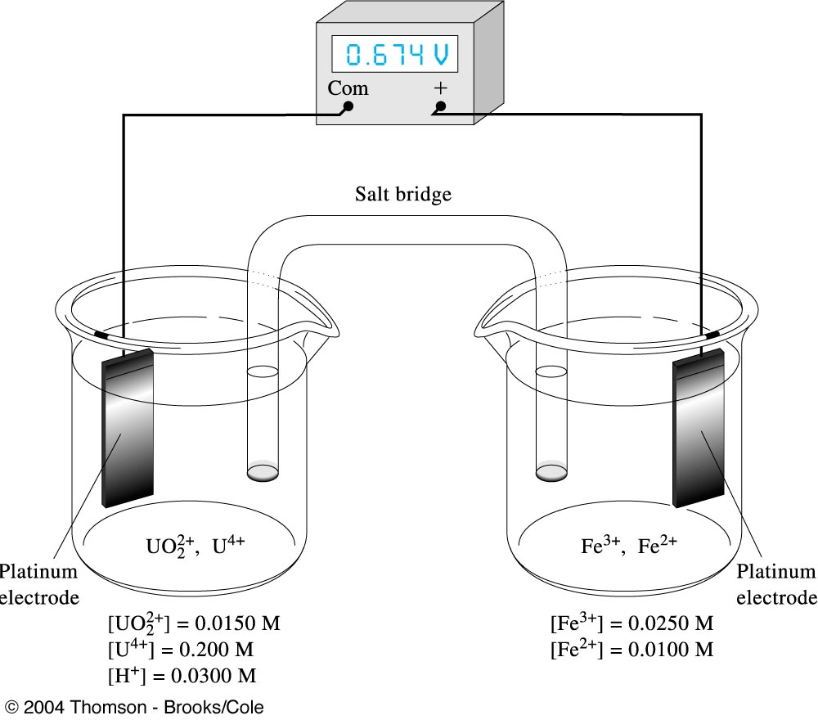
Example
Calculate the potential of the following cell and indicate the reaction that would occur spontaneously if the cell were short-circuited.
Pt U⁴⁺(0.200M), UO₂²⁺(0.0150M), H⁺(0.300M) Fe²⁺(0.0100M), Fe³⁺ (0.0250M) Pt

Slide 4
Solution
The two half-reactions are
Fe³⁺ + e_ ↔ Fe²⁺ E^{o =} + 0.771V
UO₂²⁺ + 4H⁺ + 2e⁻ ↔ U⁴⁺ + 2H₂O E^{o =} + 0.334V
The electrode potential for the right-hand electrode is
E_{right} = 0.771 – 0.05916 log [Fe ²⁺]/[Fe ³⁺]
= 0.771 – 0.05916 log 0.0100/0.0250 = 0.771 – (– 0.0236)
= 0.7946 V

Slide 5
The electrode potential for the left-hand electrode is
E_{Left} = 0.334 – (0.0592 / 2) log [U⁴⁺ ] / [UO₂²⁺][ H⁺]⁴
= 0.334 – (0.0592 / 2) log 0.200 / (0.0150) (0.0300) ⁴
= 0.334 – 0.2136 = 0.1204 V
And
E _{cell} = E _{right} – E _{left} = 0.7946 – 0.2136 = 0.674V
The positive sign means that the spontaneous reaction is the oxidation of U⁴⁺ on the left and the reduction of Fe ³⁺ on the right
OR
U⁴⁺ +2 Fe ³⁺ + 2H₂O ↔ UO₂²⁺ +Fe ²⁺ + 4H⁺

Slide 6
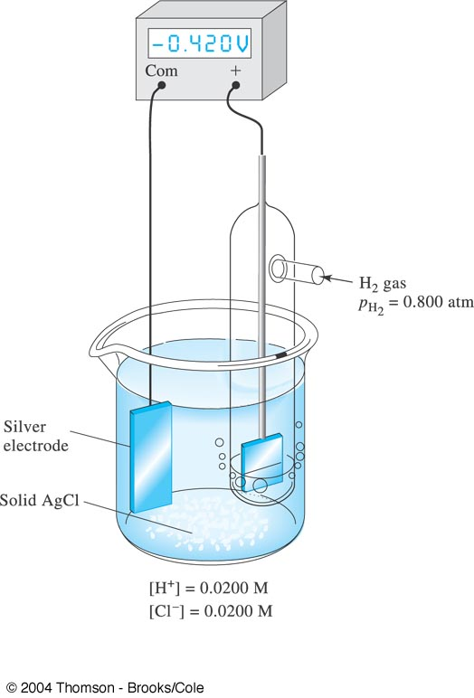
Example
Calculate the cell potential for
Ag AgCl (sat’d), HCl (0.0200M) H₂(0.800atm ), Pt
Note that this cell does not require two compartments (nor a salt bridge) because molecular H₂ has little tendency to react directly with the low concentration of Ag⁺ in the electrolyte solution. This is an example of a cell without liquid junction.

Slide 7
Solution
The two half- reactions and their corresponding standard electrode potentials are
2H⁺ + 2e ⁻ ↔ H₂ Eº_{H+/H2} = 0.000V
AgCl(s) + e ⁻ ↔ Ag (s) + Cl– Eº_{AgCl/Ag} = 0.222V
The two electrode potentials are
E_{right} = 0.000 – (0.0592/2)log p_{H2} / [H⁺]²
= – (0.0592/2) log 0.800 / (0.0200) ³
= – 0.0977 V
E_{left} = 0.222 – 0.0592*log [Cl⁻] = 0.222 – 0.0592 log (0.0200)
= 0.3226V

Slide 8
The cell potential is thus
E _{cell} = E _{right} – E _{left} = -0.0977 – 0.3226
= – 0.420V
The negative sign indicates that the cell reaction as considered
2H⁺ + 2 Ag(s) ↔ H₂ + 2AgCl(s)
is nonspontaneous.
To get this reaction to occur, we would have to apply an external voltage and construct an electrolytic cell.

Slide 9
Titration curve : potentiometric titration of Fe²⁺ with Ce⁴⁺.
Titration reaction: Ce⁴⁺ + Fe²⁺ → Ce³⁺ + Fe³⁺
Cell: Hg⏐Hg₂Cl₂⏐Cl– || Ce⁴⁺ , Ce³⁺ , Fe³⁺, Fe²⁺ | Pt
Reaction at the SCE reference electrode:
2Hg(l) + 2 Cl– ↔ Hg₂Cl₂(s) + 2 e Eº = 0.241V
Reaction at the Pt indicator electrode:
Fe³⁺ + e ↔ Fe²⁺ Eº = 0.767V (in 1M HClO₄ )
Ce⁴⁺ + e ↔ Ce³⁺ Eº = 1.70V (in 1M HClO₄ )
Cell reaction: 2Fe³⁺ + 2Hg(l) + 2 Cl– ↔ 2 Fe²⁺ + Hg₂Cl₂(s)
2Ce⁴⁺ + 2Hg(l) + 2 Cl– ↔ 2 Ce³⁺ + Hg₂Cl₂(s)
Apparatus for potentiometric titration of Fe²⁺ with Ce⁴⁺.

Slide 10
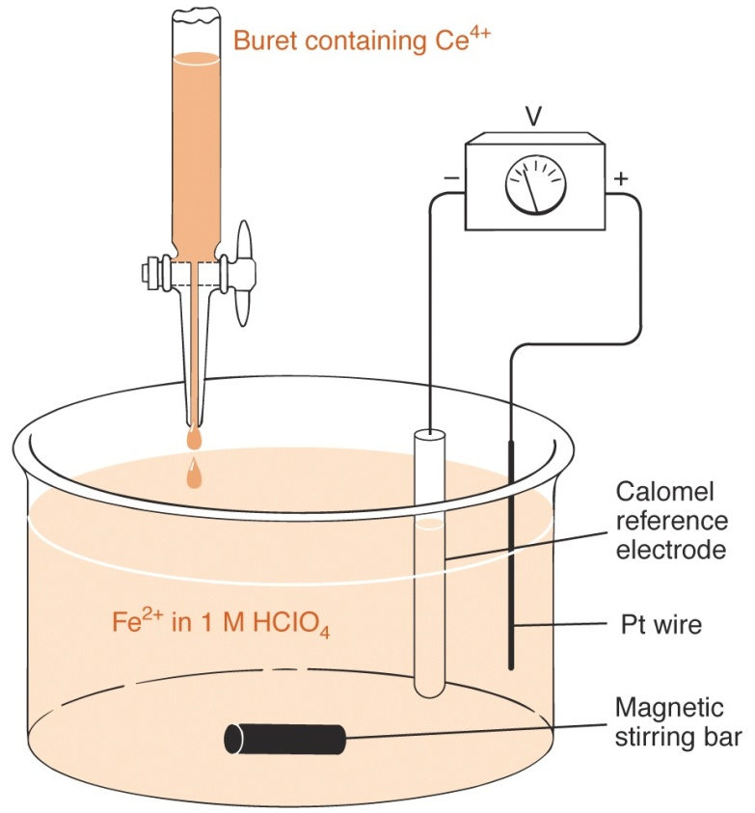

Slide 11
E_{Ce} = E_{Fe} = E_{solution}
E_{cell} = E_{cathode} – E_{anode} = E_{solution} – E_{SCE}
Eº_{cell} = (0.767)– (0.241) = 0.526 V
The equilibium constant for this titration reaction
K = 10 ^{nEo/0.05916}
log K = n Eº_{cell} / 0.05916 = (1) (0.526) / (0.05916)
= 8.8911
K = 7.783 × 10⁸

Slide 12
Redox indicator
In_{(oxidized)} + ne ↔ In_{(reduced)}
E = Eº – (0.05916 / n) log [In_{(reduced)}] / [In_{(oxidized)}]
[In_{(reduced)}] = [In_{(oxidized)}] E = Eº ± (0.05916 / n)
[In_{(reduced)}] / [In_{(oxidized)}] ≥ (10/1) [In_{(reduced)}]
[In_{(reduced)}] / [In_{(oxidized)}] ≤ (1/10) [In_{(oxidized)}]
Color changes for general redox indicators depend only on the potential of the system.
The range of potentials over which a color change occurs (the transition potential) is often pH dependent.

Slide 14
Classification of electrochemical methods
POTENTIOMETRY Measure electrical potential developed by an electrode in an electrolyte solution at zero current flow. Use Nernst equation relating potential to concentration of some ion in solution.
VOLTAMMETRY Determine concentration of ion in dilute solutions from current flow as a function of voltage when POLARIZATION of ion occurs around the electrode. POLARIZATION = depletion of concentration caused by electrolysis. If using a dropping mercury electrode, method is termed POLAROGRAPHY.

Slide 15
COULOMETRY Electrolysis of a solution and use of Faraday's law* relating quantity of electrical charge to amount of chemical change. [* essentially states that it takes 9.65 x 10⁴ Coulombs of electrical charge to cause electrolysis of 1 mole of a univalent electrolyte species.]
CONDUCTIMETRY Measure conductance of a solution, using INERT ELECTRODES, ALTERNATING CURRENT, AND AN ELECTRICAL NULL CIRCUIT - thereby ensure no net current flow and no electrolysis. The concentration of ions in the solution is estimated from the conductance.
NOTE: Methods 1 and 4, NO electrolysis of solution. Sample recoverable, unaltered by analysis.
Methods 2 and 3 must cause ELECTROLYSIS OF THE SAMPLE.

Slide 16
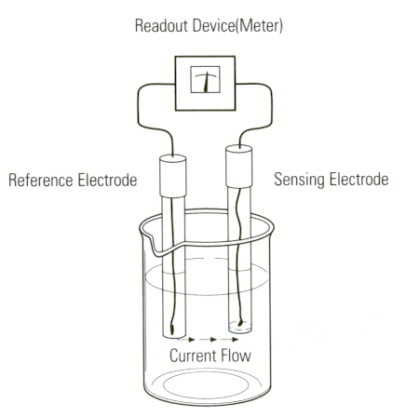
Potentiometry
An electroanalytical technique based on the measurement of the electromotive force of an electrochemical cell comprised of a measuring and a reference electrode.
The simplest example of a measuring electrode is a metal electrode whose potential depends on the concentration of the cation of the electrode metal.
Indicator electrode
Electrochemical measuring system.

Slide 17
AC: slide wire
B: position of the sliding contact
G: galavanometer
K: key
R: resistance
S: double-pole double-throw switch
T: battery
Es: standard cell
ex. Weston cell
(-)Cd(Hg)| 3CdSO₄8H₂O(sat);Hg₂SO4(s)|Hg(+)
Ex: unknown cell
Potentiometer
T
R
A
C
B
Es
G
K
S
Ex
G. Svehla(ed), Comprehensive Analytical Chemistry, II part A, Elsevier, pp 88-89 1964.

Slide 18
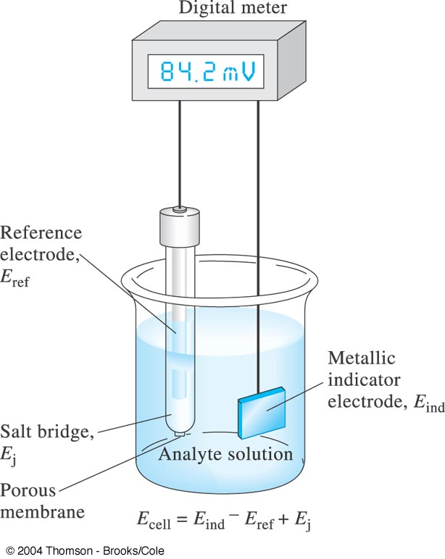
General Principles
Reference electrode | salt bridge | analyte solution | indicator electrode
E_{ref} E_{j} E_{ind}
E_{cell} = E_{ind} – E_{ref} + E_{j}
Reference cell :
a half cell having a known electrode potential
Indicator electrode:
has a potential that varies in a known way
with variations in the concentration of an analyte
A cell for potentiometric determinations.

Slide 19
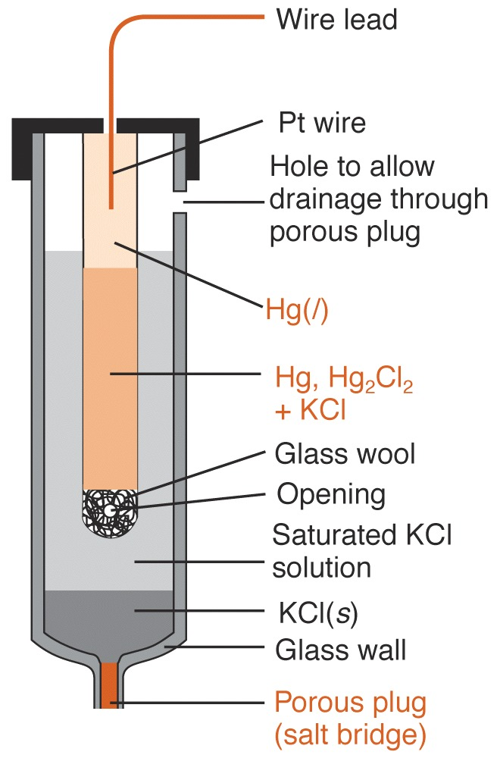
Reference electrodes
maintains a fixed potential
1) Saturated calomel electrode (S.C.E.)
Hg(l) | Hg₂Cl₂ (sat’d), KCl (sat’d) | |
electrode reaction in calomel half-cell
Hg₂Cl₂ (s) + 2e = 2Hg(l) + 2Cl–
Eº = + 0.268V
E = Eº – (0.05916/2) log[Cl–]² = 0.244 V
Temperature dependent

Slide 20
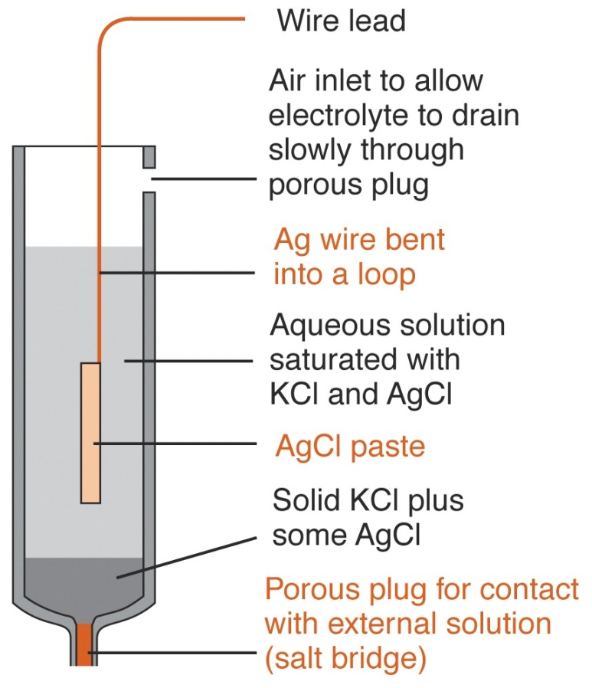
2) Silver-silver chloride electrode
Ag(s) | AgCl (sat’d), KCl (xM) | |
AgCl(s) + e = Ag(s) + Cl–
Eº = +0.244V
E = Eº – (0.05916/1) log [Cl–]
E (saturated KCl) = + 0.199V (25ºC)

Slide 21
3) standard hydrogen electrode (SHE)
The most fundamental reference electrode in electrochemistry.
By definition its equilibrium potential is considered zero at any temperature, because this electrode was chosen as an arbitrary zero point for electrode potentials.
A zero point is needed since the potential of a single electrode cannot be measured, only the difference of two electrode potentials is measurable.
All electrode potentials are expressed on this "hydrogen scale."
It is a hydrogen electrode with an electrolyte containing unit concentration of hydrogen ions and saturated with hydrogen gas at unit atmosphere pressure.

Slide 22
standard hydrogen electrode (SHE)
This electrode can be somewhat inconvenient to use because of the need to supply hydrogen gas.
Therefore, other reference electrodes (e.g., calomel or silver/silver chloride) are often used instead, but the measured electrode potentials can be converted to the "hydrogen scale.
Also called normal hydrogen electrode.
Strictly speaking, one must use unit activity rather than concentration of hydrogen ions and unit fugacity rather than unit pressure of hydrogen gas.
Pt | H₂(g, 1.0 atm)|H⁺(aq, A= 1.0M)
½ H₂(g, 1.0 atm) = H⁺(aq, A= 1.0M) + e Eº = 0.000 V

Slide 23
Liquid-junction potential
A potential difference between two solutions of different compositions separated by a membrane type separator.
The simplest example is the case of two solutions containing the same salt in different concentrations.
The salt will diffuse from the higher concentration side to the lower concentration side.
However, the diffusion rate of the cation and the anion of the salt will very seldom be exactly the same.
Assume that the cations move faster; consequently, an excess positive charge will accumulate on the low concentration side, while an excess negative charge will accumulate on the high concentration side of the junction due to the slow moving anions.
This sets up a potential difference that will start an electromigration of the ions that will increase the net flux of the anions and decrease the net flux of the cations.

Slide 24
Liquid-junction potential
In steady-sate conditions, the two ions will move at the same speed and a potential difference will be created between the two solutions.
This "steady-sate" potential difference seems constant, but this is misleading because it slowly changes as the concentrations between the two solutions equalize.
The diffusion process will "eventually" result in equal concentrations of the salt in the two solutions separated by the membrane, and the liquid-junction potential will vanish.

Slide 25
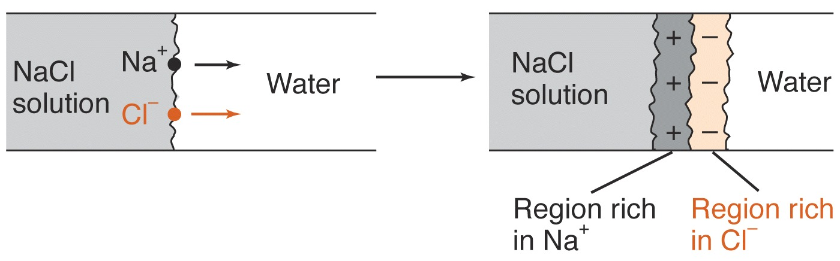
Junction potential :
a small potential that exists at the interface between two electrolyte solutions that differ in composition.
Development of the junction potential caused by unequal mobilities of ions.
Mobilties of ions in water at 25ºC:
Na⁺ : 5.19 × 10 ^{–8} m²/sV K⁺ : 7.62 × 10 ^{–8} Cl– : 7.91× 10 ^{–8}

Slide 26
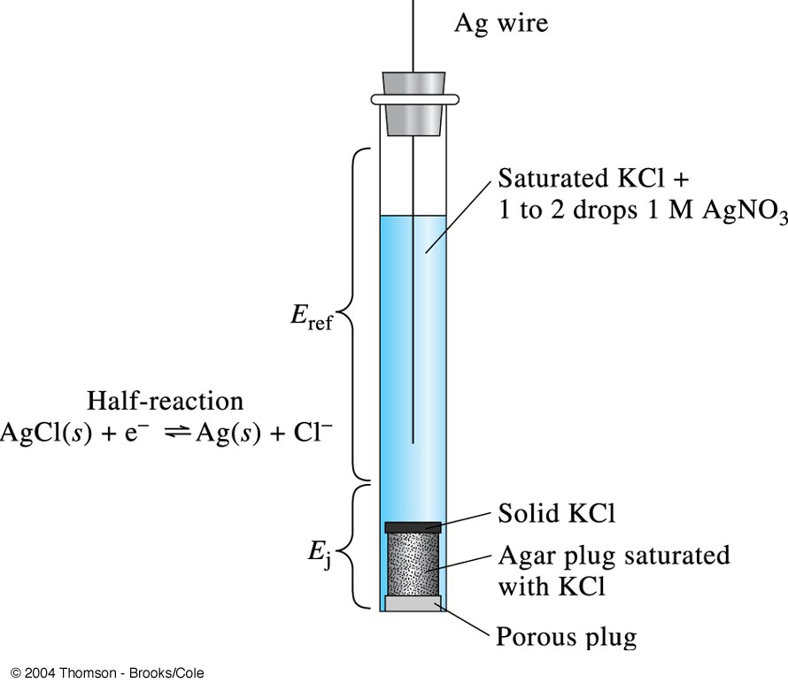
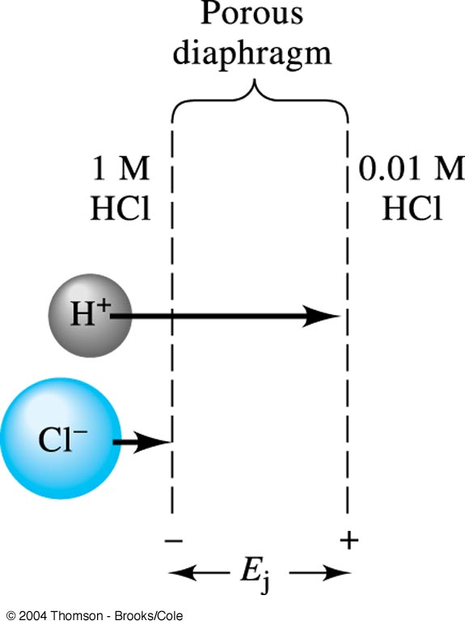
Schematic representation of a liquid junction showing the source of the junction potential, E_{j}. The length of the arrows corresponds to the relative mobilities of the ions.
Diagram of a silver/silver chloride electrode showing the parts of the electrode that produce the reference electrode potential E_{ref} and the juction potential E_{j}

Slide 28
Indicator electrodes
Indicator electrodes for potentiometric measurements are of two basic types, namely, metallic and membrane.
1) Metallic indicator electrodes :
develop a potential that is determined by the equilibrium position of redox half-reaction at the electrode surface.

Slide 29
First-order electrodes for cations :
A first order electrode is comprised of a metal immersed in a solution of its ions, such as silver wire dipping into a silver nitrate solution.
Only a few metals such as silver, copper, mercury, lead , zinc, bismuth, cadmium and tin exhibit reversible half- reactions with their ions and are suitable for use as first order electrodes.
Other metals, including iron, nickel, cobalt, tungsten, and chromium, develop nonreproducible potentials that are influenced by impurities and crystal irregularities in the solid and by oxide coatings on their surfaces.
This nonreproducible behavior makes them unsatisfactory as first-order electrodes.

Slide 30
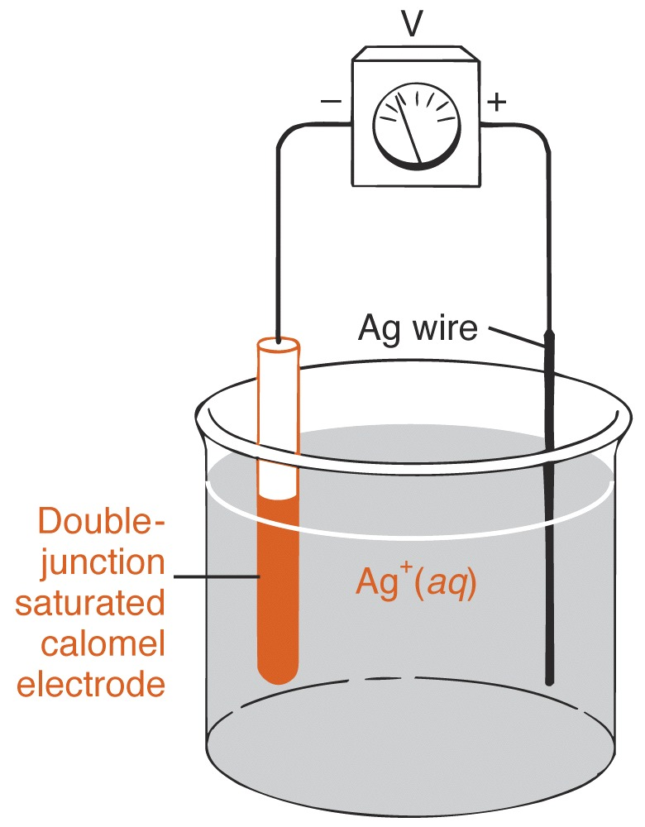
Example of First-order electrode
Ag⁺ + e = Ag(s) Eº = + 0.800V
E = 0.800 – (0.05916/1) log {1/[Ag⁺]}

Slide 31
Second-order electrodes for anions
A metal electrode can sometimes be indirectly responsive to the concentration of an anion that forms a precipitate or complex ion with cations of the metal.
Ex. 1. Silver electrode
The potential of a silver electrode will accurately reflect the concentration of iodide ion in a solution that is saturated with silver iodide.
AgI(s) + e = Ag(s) + I– Eº = – 0.151V
E = – 0.151 – (0.05916/1) log [I–]
= – 0.151 + (0.05916/1)pI

Slide 32
Example 2
Mercury electrode for measuring the concentration of the EDTA anion Y^{4–}.
Mercury electrode responds in the presence of a small concentration of the stable EDTA complex of mercury(II).
HgY^{2–} + 2e = Hg(l) + Y^{4–} Eº = 0.21V
E = 0.21 – (0.05916/2) log ([Y^{4–}] /[HgY^{2–}])
K = 0.21 – (0.05916/2) log (1 /[HgY^{2–}])
E = K – (0.05916/2) log [Y^{4–}] = K +(0.05916 / 2) pY

Slide 33
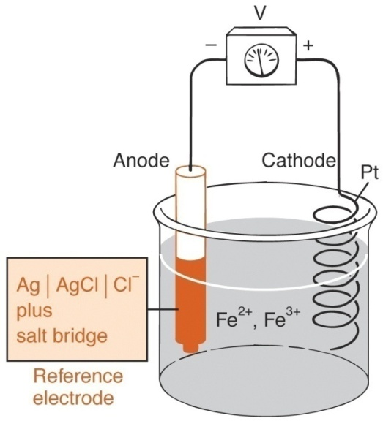
Inert electrodes
Chemically inert conductors such as gold, platinum, or carbon that do not participate, directly, in the redox process are called inert electrodes. The potential developed at an inert electrode depends on the nature and concentration of the various redox reagents in the solution.
Ag(s) | AgCl[sat’d], KCl[xM] | | Fe²⁺,Fe³⁺) | Pt
Fe³⁺+e = Fe²⁺ Eº = +0.770V
E_{cell} = E_{indicator} – E_{reference}
= {0.770 – (0.05916/1) log [Fe²⁺]/[Fe³⁺]} – {0.222 – (0.05916/1) log [Cl–]}

Slide 34
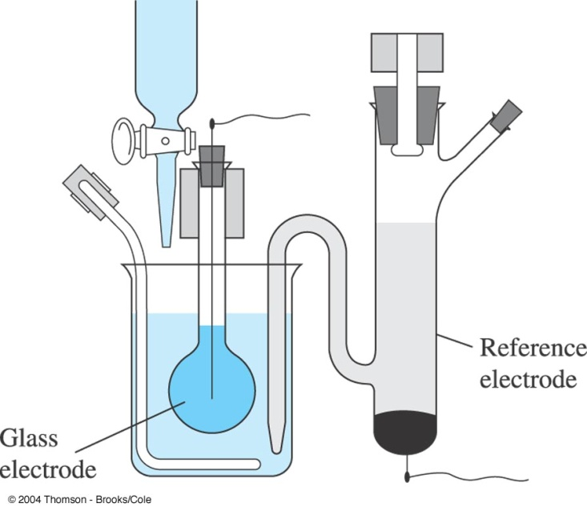
2) Membrane indicator electrodes
The potential developed at this type of electrode results from an unequal charge buildup at opposing surface of a special membrane. The charge at each surface is governed by the position of an equilibrium involving analyte ions, which, in turn, depends on the concentration of those ions in the solution.
The electrodes are categorized according to the type of membrane they employ :
glass,
polymer,
crystalline,
gas sensor.
The first practical glass electrode. (Haber and Klemensiewcz, Z. Phys. Chem, 1909, 65, 385.

Slide 35
2) Membrane indicator electrodes
Interaction of the analyte with the membrane results in a membrane potential if there is a difference in the analyte’s concentration on opposite sides of the membrane.
One side of the membrane is in contact with an internal solution containing a fixed concentration of analyte, while the other side of the membrane is in contact with the sample.
Current is carried through the membrane by the movement of either the analyte or an ion already present in the membrane’s matrix.

Slide 36
Membrane indicator electrodes
Glass membrane pH electrodes
The internal element consists of silver-silver chloride electrode immersed in a pH 7 buffer saturated with silver chloride.
The thin, ion-selective glass membrane is fused to the bottom of a sturdy, nonresponsive glass tube so that the entire membrane can be submerged during measurements.
When placed in a solution containing hydrogen ions, this electrode can be represented by the half-cell :
Ag(s) | AgCl[sat’d], Cl–(inside), H⁺(inside) | glass membrane | H⁺(outside)
E = Eº – (0.05916/1) log [Cl–] + (0.05916/1) log ([H⁺(outside)]/[H⁺(inside)])

Slide 37
pH Meter
pH meter is a volt meter that measures the electrical potential difference between a pH electrode and a reference electrode and displays the result in terms of pH value of the sample solution in which they are immersed
The pH meter measures the pH of a solution using an ion-selective electrode (ISE) that responds to the H⁺ concentration of the solution.
The pH electrode produces a voltage that is proportional to the concentration of the H⁺ concentration, and making measurements with a pH meter is therefore a form of potentiometry.
The pH electrode is attached to control electronics which convert the voltage to a pH reading and displays it on a meter.

Slide 38
pH meter instrumentation
A pH meter consists of a H⁺-selective membrane, an internal reference electrode, an external reference electrode, and a meter with control electronics and display.
Commercial pH electrodes usually combine all electrodes into one unit that are then attached to the pH meter.

Slide 39
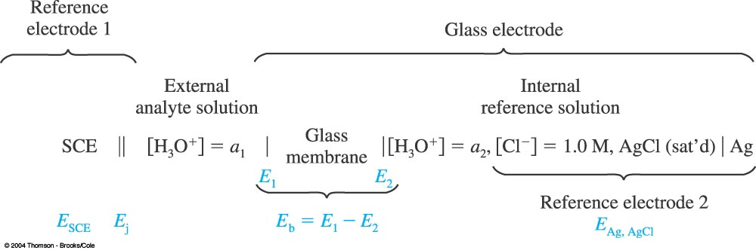
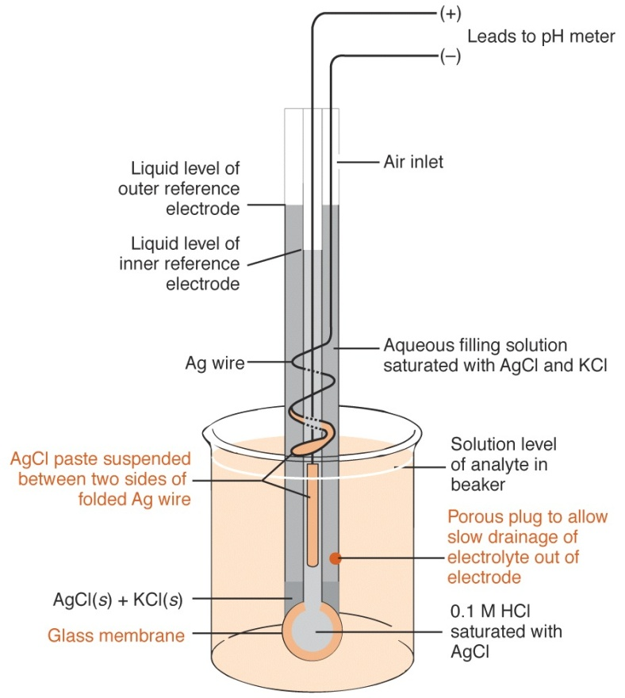

Slide 40
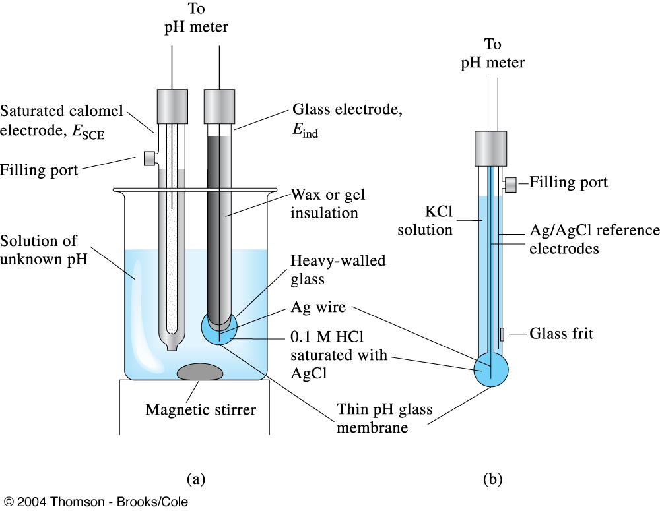
(a) Glass electrode (indicator) and saturated calomel electrode (reference) immersed in a solution of unknown pH.
Combination probe consisting of both an indicator glass electrode and a silver/silver chloride reference. A second silver/silver chloride electrode serves as the internal reference for the glass electrode. The two electrodes are arranged concentrically with the internal reference in the center and the external reference outside. The reference makes contact with the analyte solution through the glass frit or other suitable porous medium. Combination probes are the most common configuration of glass electrode and reference for measuring pH.

Slide 41
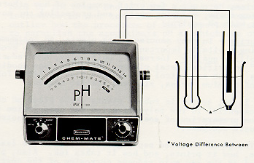
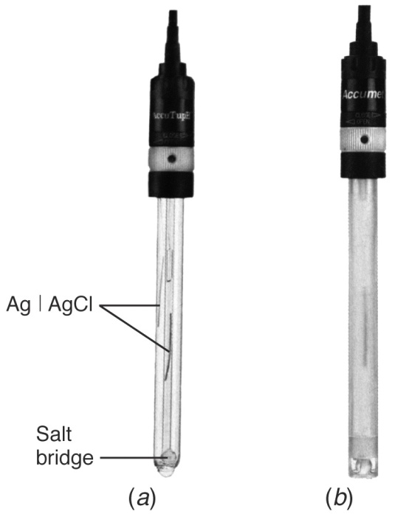
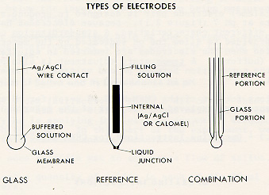
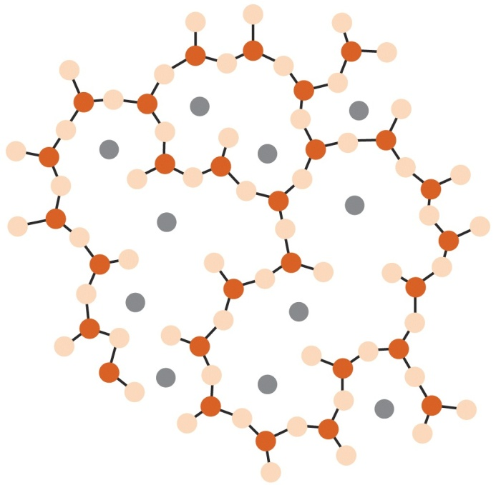

Slide 42
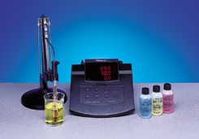
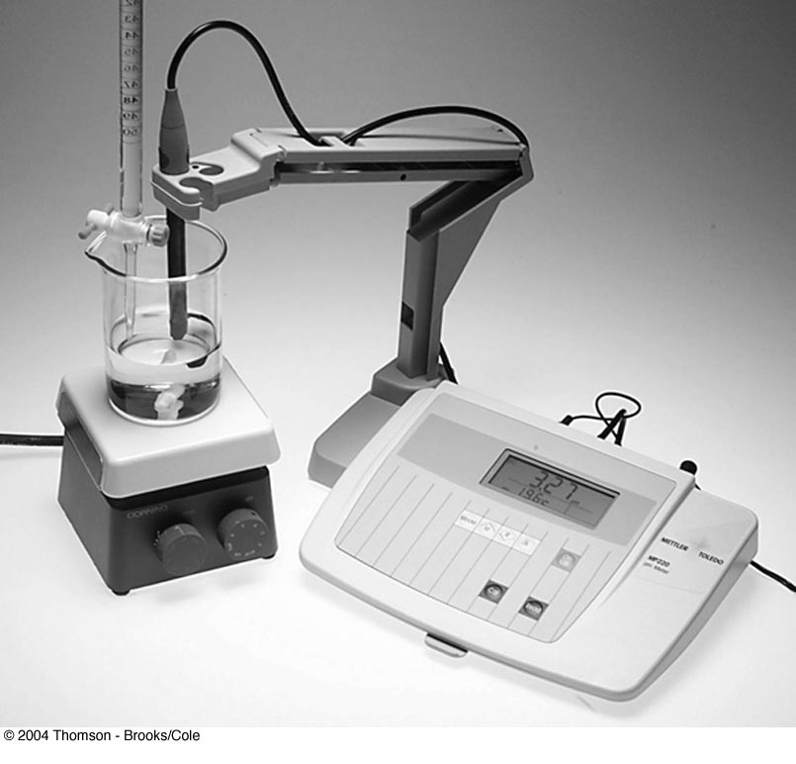
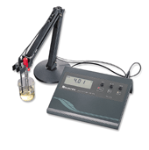
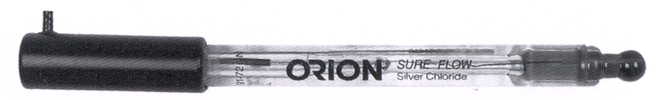
pH Meters

Slide 43
Ion-Selective Electrodes (ISE)
An Ion-Selective Electrode (ISE) produces a potential that is proportional to the concentration of an analyte.
Making measurements with an ISE is therefore a form of potentiometry.
The most common ISE is the pH electrode, which contains a thin glass membrane that responds to the H⁺ concentration in a solution.

Slide 44
ISE (ion selective electrode)
Any electrode that preferentially responds to one species.
1. Glass membrane electrode : H⁺
2. Liquid membrane electrodes
3. Solid state and precipitate electrodes
4. Gas sensing electrodes
5. Enzyme electrodes
Selectivity coefficient
k_{X,Y} = (response to Y) / (response to X)

Slide 45
Applications of ion selective electrodes
Ion-selective electrodes are used in a wide variety of applications for determining the concentrations of various ions in aqueous solutions. The following is a list of some of the main areas in which ISEs have been used.
Pollution Monitoring: CN, F, S, Cl, NO₃ etc., in effluents, and natural waters.
Agriculture: NO₃, Cl, NH₄, K, Ca, I, CN in soils, plant material, fertilisers and feedstuffs.
Food Processing: NO₃, NO₂ in meat preservatives.
Salt content of meat, fish, dairy products, fruit juices, brewing solutions.
F in drinking water and other drinks.

Slide 46
Applications of ion selective electrodes
Ca in dairy products and beer.
K in fruit juices and wine making.
Corrosive effect of NO₃ in canned foods.
Detergent Manufacture: Ca, Ba, F for studying effects on water quality.
Paper Manufacture: S and Cl in pulping and recovery-cycle liquors.
Explosives: F, Cl, NO₃ in explosive materials and combustion products.
Electroplating: F and Cl in etching baths; S in anodising baths.
Biomedical Laboratories: Ca, K, Cl in body fluids (blood, plasma, serum, sweat).
F in skeletal and dental studies.
Education and Research: Wide range of applications.

Slide 47
Electrogravimetry and
coulometry

Slide 48
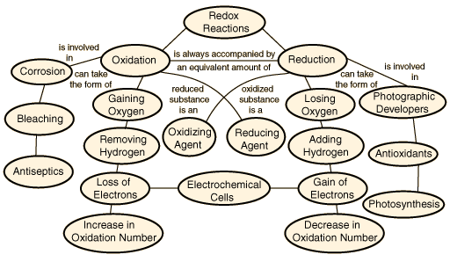

Slide 49
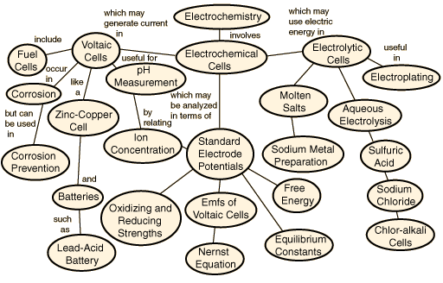

Slide 50
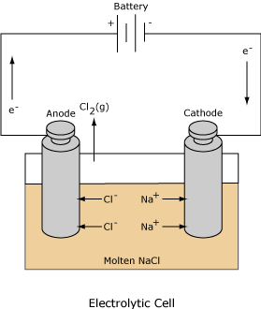
Electrolytic Cells
The redox reaction in an electrolytic cell is nonspontaneous. Electrical energy is required to induce the electrolysis reaction. An example of an electrolytic cell is shown below, in which molten NaCl is electrolyzed to form liquid sodium and chlorine gas.
The sodium ions migrate toward the cathode, where they are reduced to sodium metal.
Similarly, chloride ions migrate to the anode and are oxided to form chlorine gas.
This type of cell is used to produce sodium and chlorine. The chlorine gas can be collected surrounding the cell.
The sodium metal is less dense than the molten salt and is removed as it floats to the top of the reaction container.

Slide 51
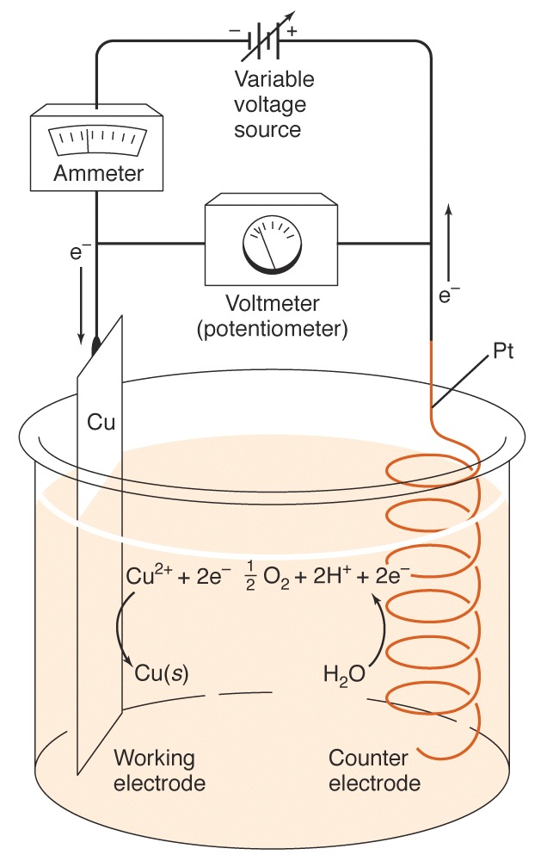
Electrolysis experiment
Direct current (dc) is current that is always in one direction; it is unidirectional. The direction of alternating current (ac) reverses periodically.
DC voltage sources are often given the battery symbol with + and – polarities.
An arrow through the battery indicates that the source voltage is variable and can be changed to another dc value.
Cathode (working electrode):
2 Cu ²⁺ + 2e = Cu(s)
Anode (counter electrode):
H₂O = ½O₂(g) + 2H⁺ + 2e
Net reaction:
H₂O + Cu²⁺ = Cu(s) + ½O₂(g) + 2H⁺

Slide 52
Current and potential changes during an electrolysis
Whenever current flows, three factors act to decrease the output voltage of galvanic cell or to increase the applied voltage needed for electrolysis.
1) Ohmic potential ; Ohmic drop
The voltage needed to force current (ions) to flow through the cell.
E_{ohmic} = IR
The output voltage of a galvanic cell is decreased by IR.
E_{galvanic} = E_{equilibrium} – IR
The magnitude of the applied voltage for an electrolysis cell must be more negative than the thermodynamic cell potential by IR in order for current to flow.
E_{applied} = E_{cathode} – E_{anode} – IR
= E_{cell} – IR

Slide 53
Example
Ag | AgCl(s), Cl– (0.200M), Cd²⁺ (0.00500M) | Cd
Assume that the internal resistance of the cell is 15.0 Ω.
Calculate the potential that must be applied to cause an electrolytic current of 2.00 mA to develop.
Cd²⁺ + 2e ↔ Cd (s) Eº = – 0.403 V
AgCl (s) + e ↔ Ag (s) + Cl– Eº = 0.222 V
E_{cathode} = – 0.403 – (0.05916 / 2) log (1 / 0.00500) = – 0.471 V
E_{anode} = 0.222 – (0.05916 / 1) log (0.200 / 1) = 0.263 V
E_{applied} = E_{cell} – IR = E_{cathode} – E_{anode} – IR
= – 0.471 V – 0.263 V – (2.00 × 10^{–3} A) × 15.0 Ω
= – 0.764 V

Slide 54
Polarization effects
The term polarization refers to the deviation of the electrode potential from the value predicted by the Nernst equation on the passage of current.
Cells that exhibit nonlinear behavior at higher currents exhibit polarization, and the degree of polarization is given by an overvoltage or overpotential.

Slide 55
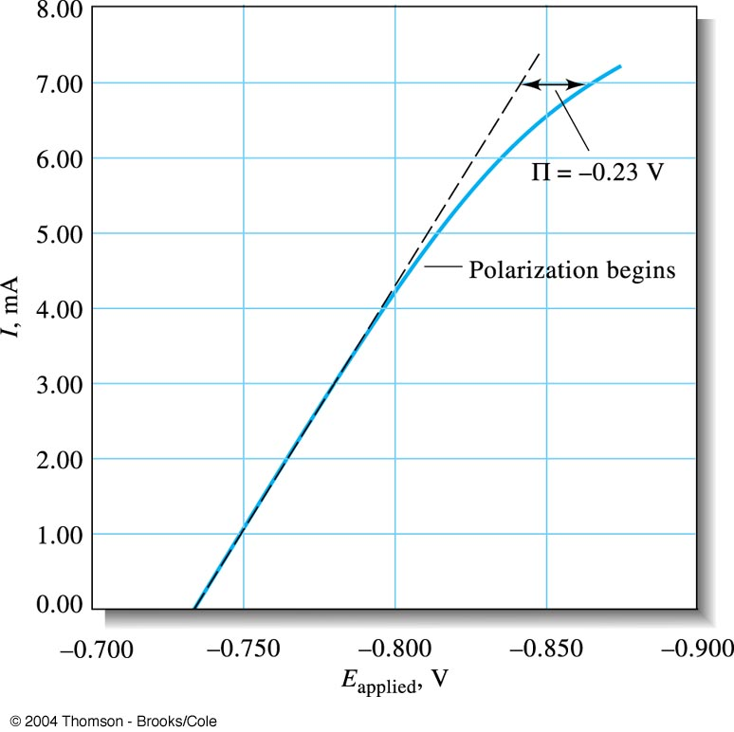
Polarization effects
I = (E_{cell} – E_{applied}) / R = – (E_{applied} / R) + (E_{cell} / R)
Overvoltage (Π) is the potential difference between the theoretical cell potential from E_{applied} = E_{cell} – IR and the actual cell potential at a given level of current.
E_{applied} = E_{cell} – IR – Π

Slide 56
Factors that influence polarization
electrode size, shape, and composition
composition of the electrolyte solution
temperature and stirring rate
current level
physical state of species involved in the cell reaction

Slide 57
Concentration Polarization
Concentration polarization occurs because of the finite rate of mass transfer from the solution and an electrode surface.
The electrode potential depends on the concentration of species in the region immediately surrounding the electrode.
When ions are not transported to or from an electrode as rapidly as they are consumed or created, we say that concentration polarization exists.
Concentration polarization means that [X]_{s} ≠ [X]_{o,} , where [X]_{o} is the concentration of X in the bulk solution and [X]_{s} is concentration of X in the immediate vicinity of the electrode surface.

Slide 58
Concentration Polarization
Reactants are transported to and products away from an electrode by three mechanisms:
(1) diffusion, (2) migration, (3) convection (as a result of stirring, vibration, or temperature gradients)
To decrease concentration polarization :
(1) Raise the temperature.
(2) Increase stirring
(3) Increase electrode surface area.
(4) Change ionic strength

Slide 59
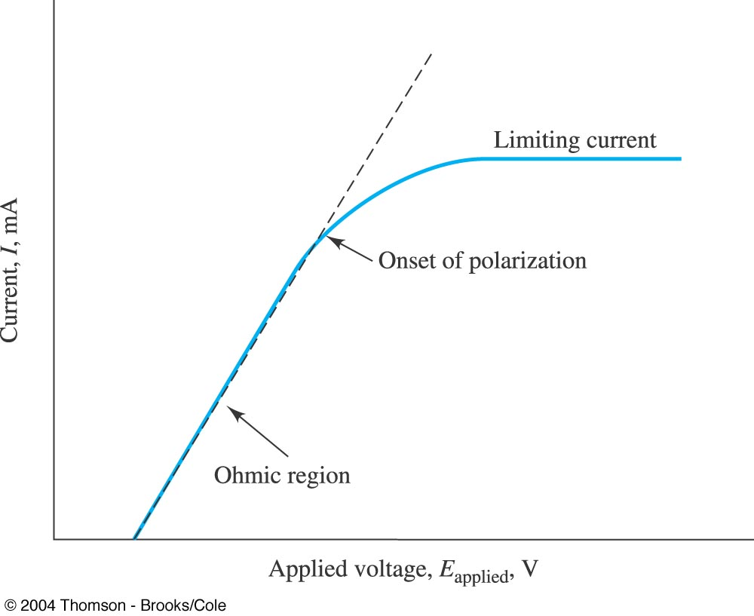
Current-potential curve for electrolysis showing the linear or ohmic region, the onset of polarization, and the limiting current plateau. In the limiting current region, the electrode is said to be completely polarized, since its potential can be changed widely without affecting the current.

